Slide 1
GPS vs IMU Dead Reckoning Experiment
Andrew Tu
EECE 5698 Robotics Sensing and Navigation
Northeastern University

Slide 2
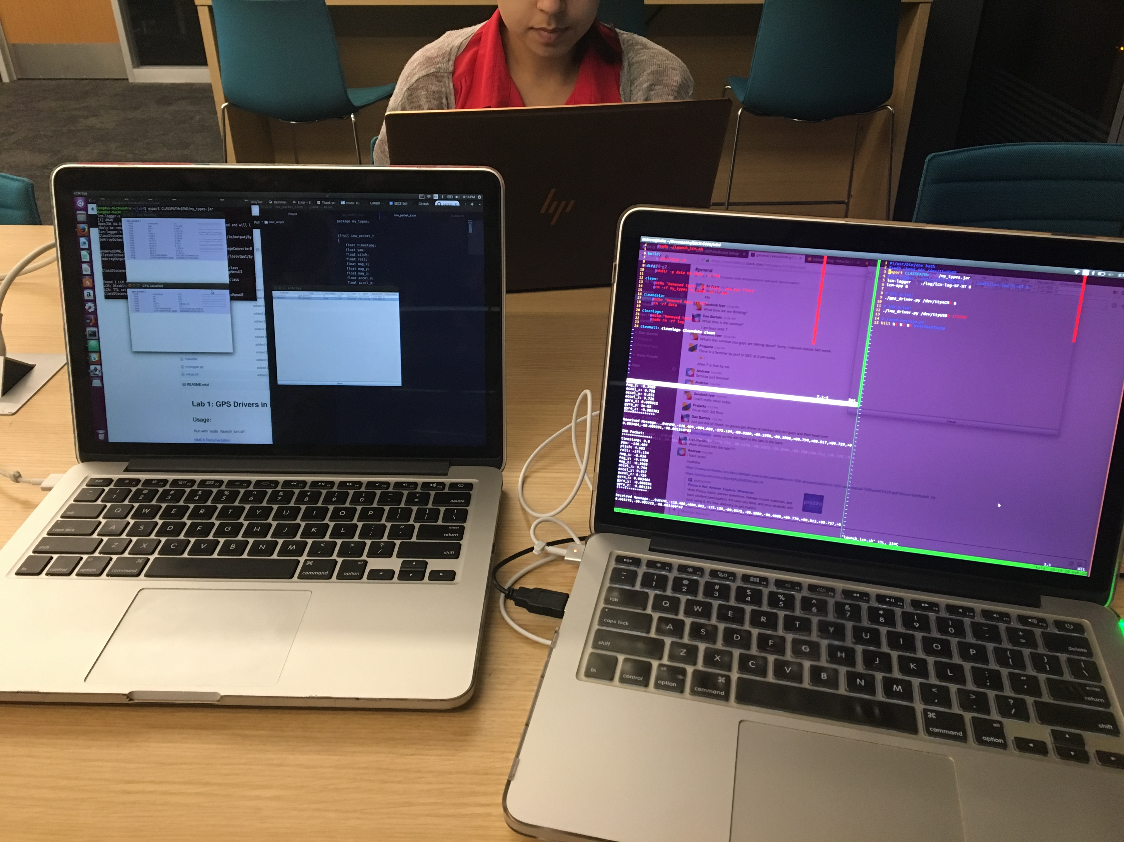
LCM Over Wireless Connection

Slide 3
\Noise Characteristic Summary
Most cases: Gaussian error distribution
In case of gyro and accelerometer, need to zero sensor to account for drift error
Mag and Roll/Pitch/Yaw sensor doesn’t matter to much b/c those are relative values
Need to calibrate magnetometer values to account for hard + soft iron distortions

Slide 4
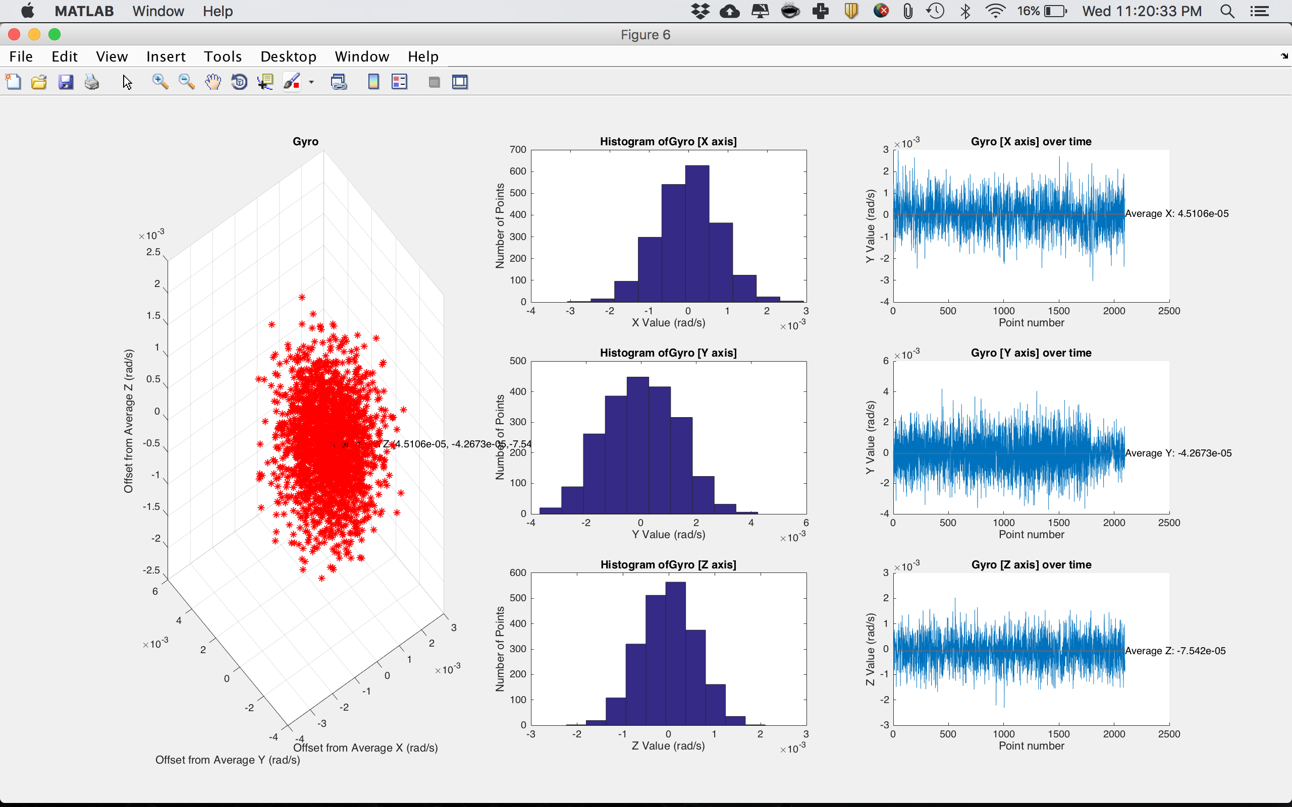
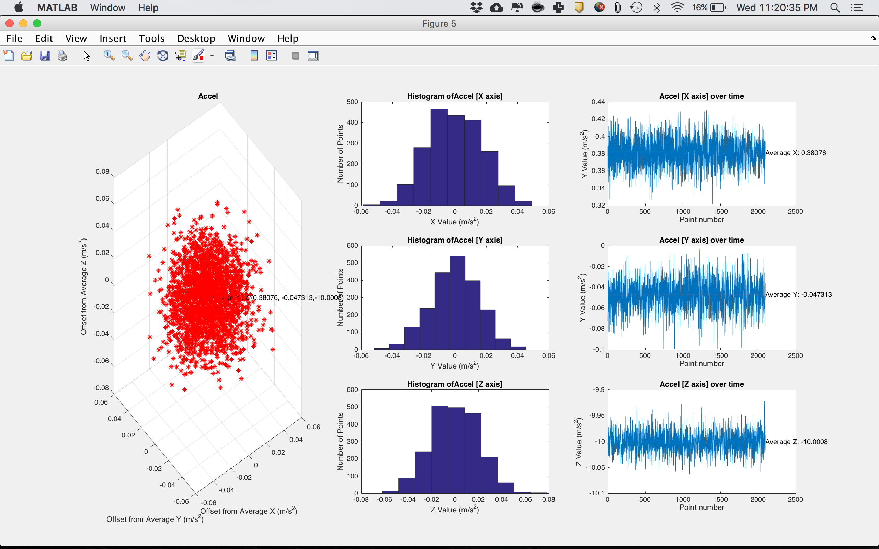
Noise Characteristics of Stationary In Car Data

Slide 5
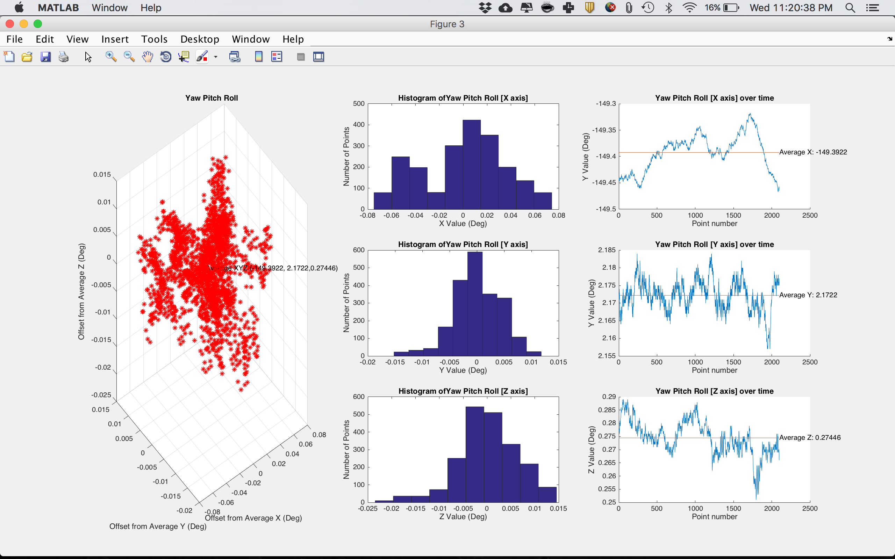
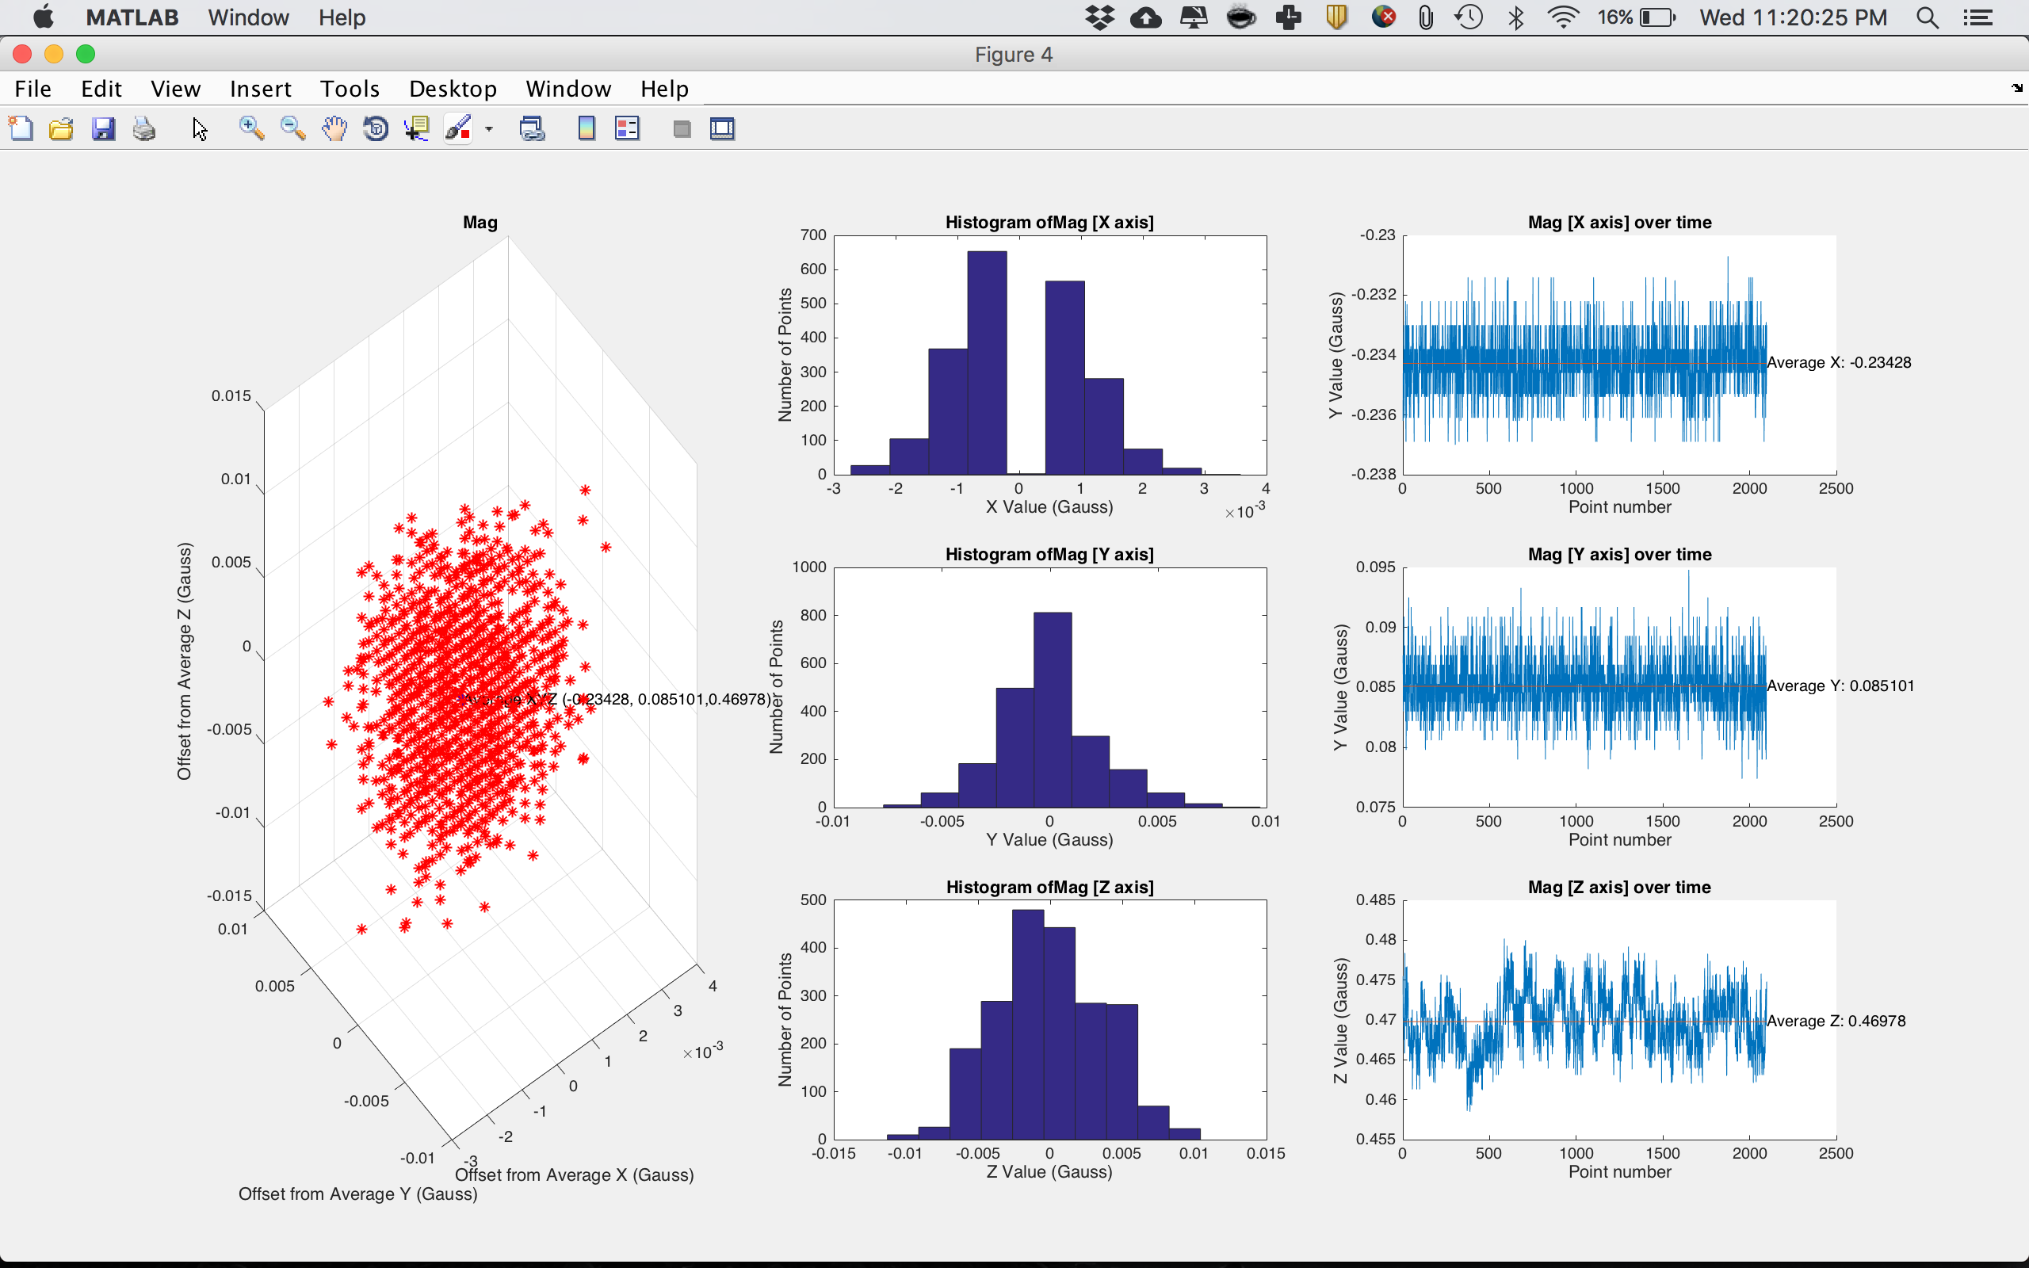
Noise Characteristics of Stationary In Car Data

Slide 6
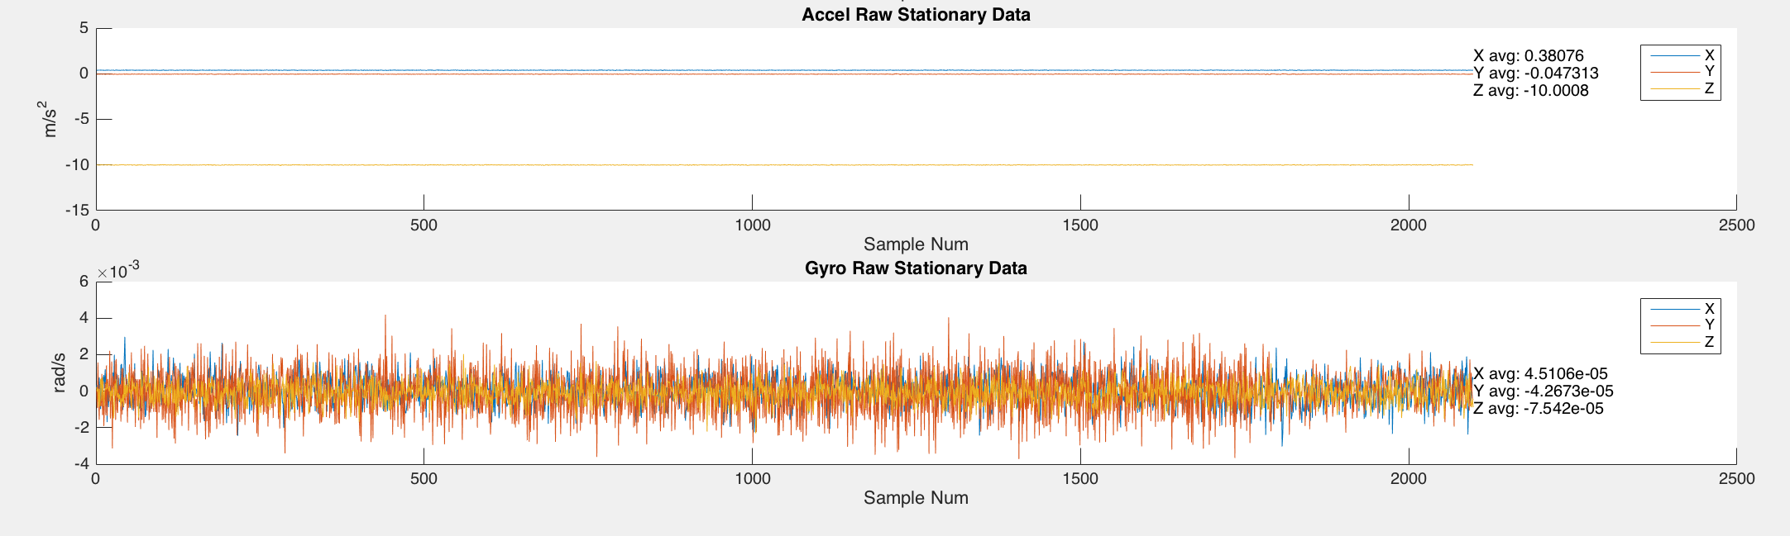
Non Zero Values for Stationary Data

Slide 7
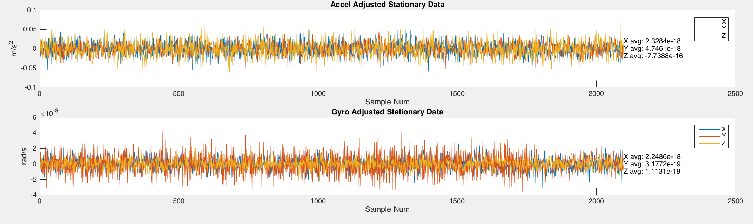
Eliminating 0 Movement Bias in Stationary Data

Slide 8
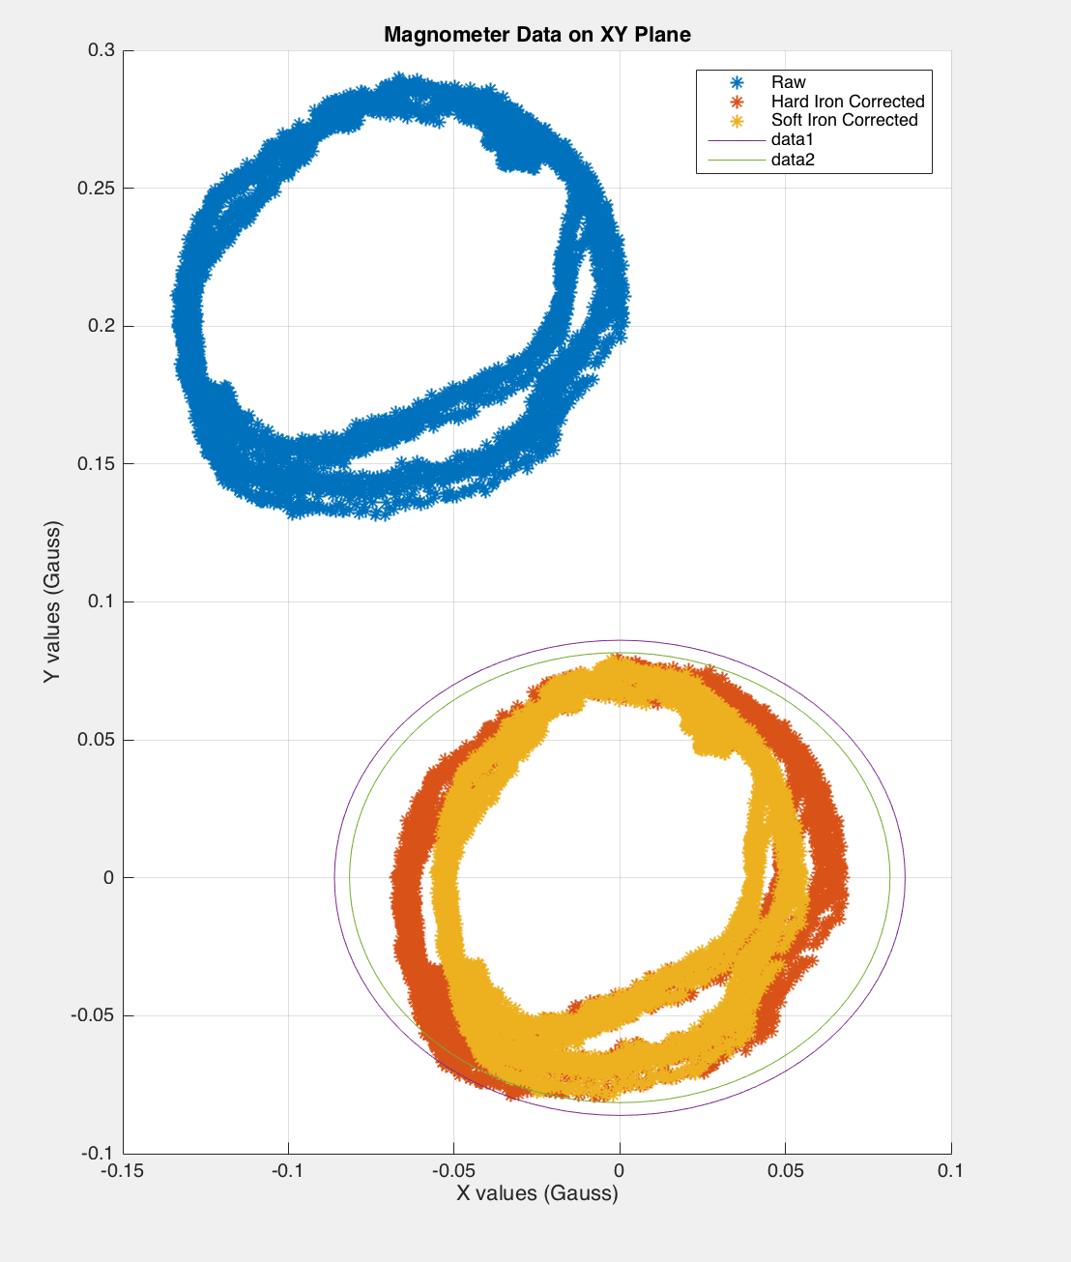
Calibrating Magnetometer (Hard + Soft Iron) (DRiving in Circles)
Hard Iron Correction: Shift values to center circle around origin
Soft Iron Correction: Scale values to change oval to more circular shape

Slide 9
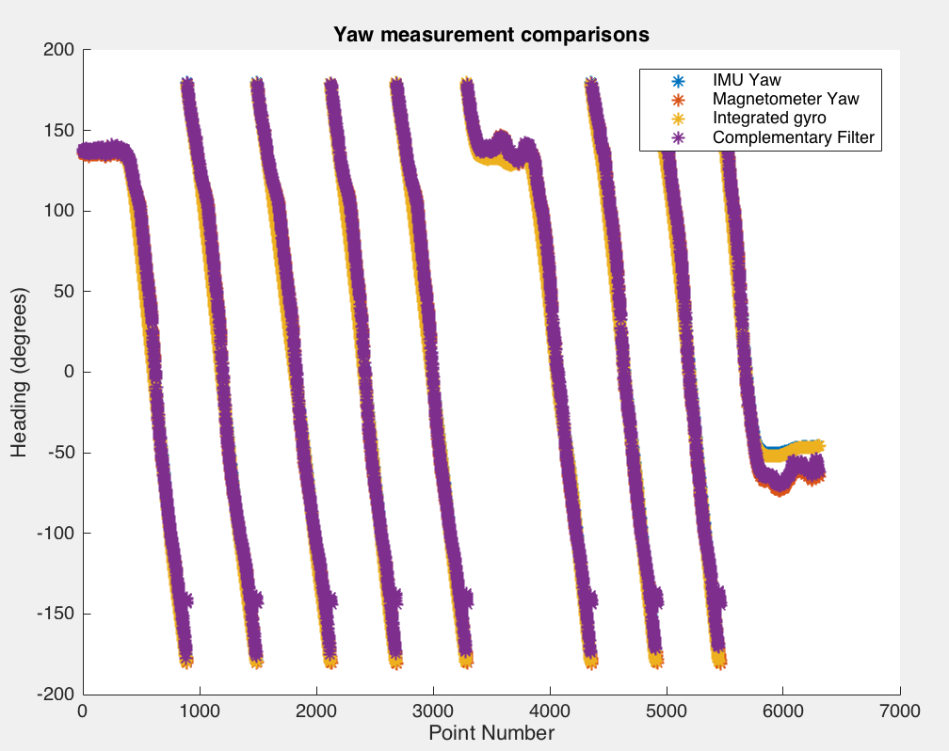
Calculated Yaw vs Given Yaw (Driving in Circles)
Integrated gyro data perfectly lines up to the given yaw.
Magnetometer results are skewed from yaw
Since Magnetometer data was more heavily weighted (90%) in the complementary filter, combined results are skewed too.
Skew in magnetometer likely a result of driving over an incline (not account for z error)

Slide 10
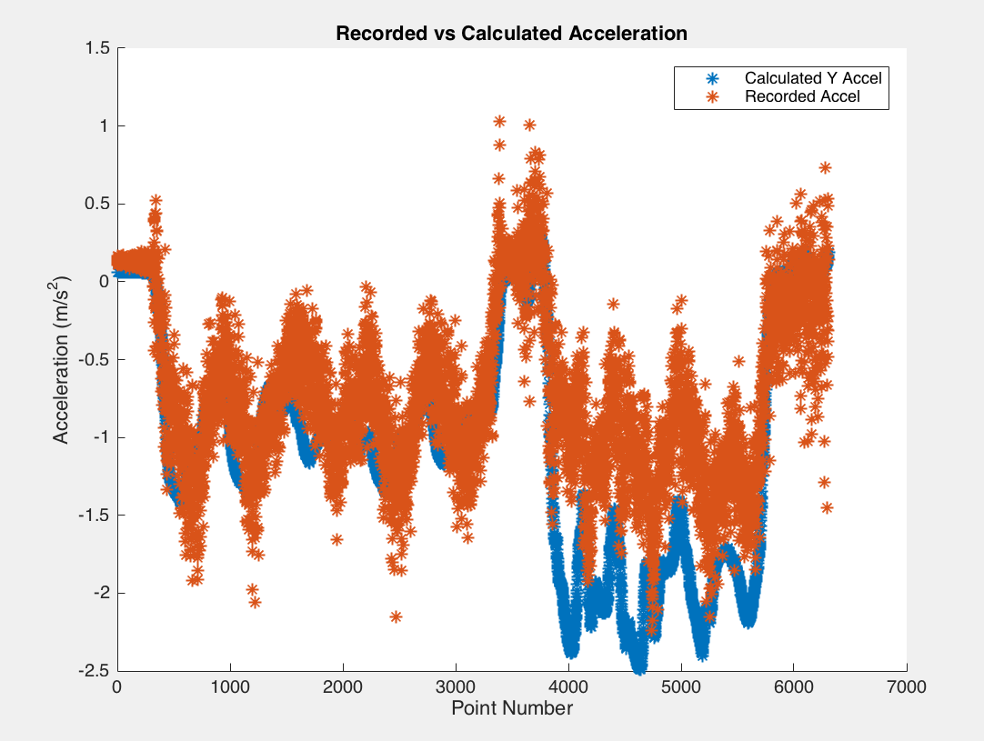
Calculated vs Recorded Acceleration (Driving in Circles)
Scale factor: 1/45 applied to the calculated value
Recorded signal is noisy compared to the values calculated from the gyroscope
Calculated value has slightly greater amplitude than the recorded value.
Calculations will drift over time as a result

Slide 11
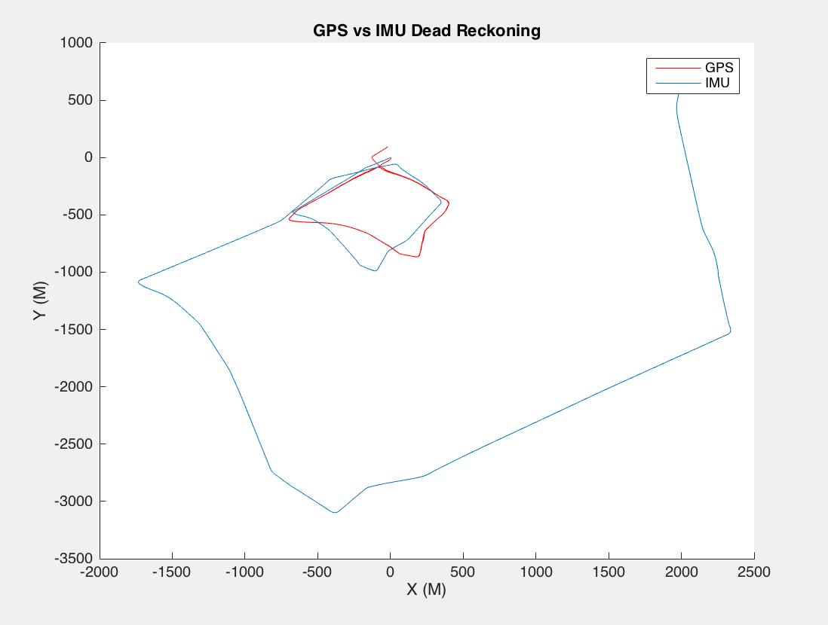
GPS vs Dead Reckoning Trajectories
Scale factor of IMU has factor of 1/45 applied
Drive consisted of two loops
First loop was accurate in terms of scale– errors mainly occurred when turning
Second loop: scale error of 2-3x in distance traveled.
Shape still matches correctly
Result of accumulating errors in drift (second round through, spent a lot of time stuck in traffic)
~80,000 data points for IMU
~ 2,000 data points for GPS

Slide 12
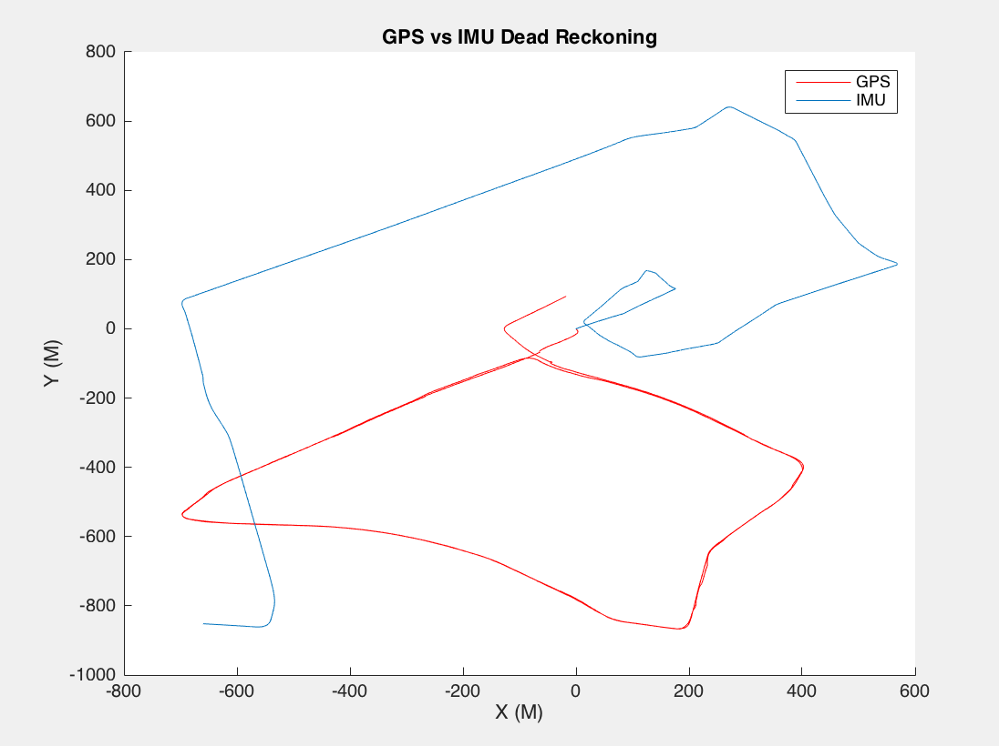
Accounting for Stationary Drift Did not improve results
Scale factor: 1/45
Accounted for the bias found in the stationary data collection
Resulting data is still not appropriately scaled (now the larger route is roughly the correct scale but the smaller box is too small)

Slide 13
Estimating X_c
Y_(accel observed) = Y_(accel calculated) + wX_velocity + delt_w *X_c
X_c = (Y_(accel observed) - Y_(accel calculated) - wX_velocity)/delt_w
Estimated X_c = ~. 1216 m

